Slide 1
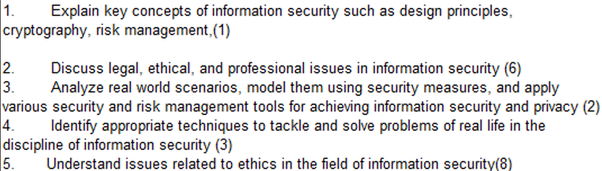
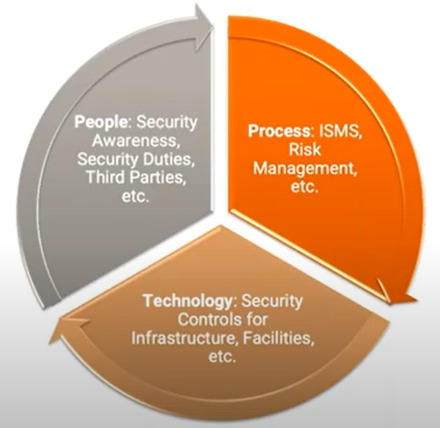
CS 3002 Information Security
Fall 2024
Week # 8 – Lecture #21, 22 and 23
8th , 9th and 10th October 2024
10th Oct 2024 -- ICETST'24
Dr. Aqsa Aslam

Slide 2
Discretionary Access Control (DAC)
DAC is a scheme allowing an entity to grant access rights to other entities, potentially violating access restrictions.
A general approach to DAC, as exercised by an operating system or a database management system, is that of an access matrix.
Access Matrix:
One dimension lists subjects (users or entities attempting access).
The other dimension lists objects (resources or data being accessed).
Matrix Entries: Each entry specifies the access rights of a subject for a specific object, detailing permissions like read, write, or execute.
Figure 4.2 Example of Access Control Structures
Notes:
As was previously stated, a discretionary access control scheme is one in which an
entity may be granted access rights that permit the entity, by its own volition, to
enable another entity to access some resource. A general approach to DAC, as
exercised by an operating system or a database management system, is that of an
access matrix. The access matrix concept was formulated by Lampson [LAMP69,
LAMP71], and subsequently refined by Graham and Denning [GRAH72, DENN71]
and by Harrison et al. [HARR76].
One dimension of the matrix consists of identified subjects that may attempt
data access to the resources. Typically, this list will consist of individual users or
user groups, although access could be controlled for terminals, network equipment,
hosts, or applications instead of or in addition to users. The other dimension lists
the objects that may be accessed. At the greatest level of detail, objects may be
individual data fields. More aggregate groupings, such as records, files, or even the
entire database, may also be objects in the matrix. Each entry in the matrix indicates
the access rights of a particular subject for a particular object.

Slide 3
Access Control Models
Access control non-trivial in practice
Complex systems ⇝ complex access control models
Some characteristics of access control models
Definition of objects and subjects
E.g. subjects can be users, processes or hosts
Representation of permissions
E.g. columns (access control lists), rows (capabilities)
Management of permissions
E.g. discretionary, mandatory or role-based access control
Figure 4.2 Example of Access Control Structures

Slide 4
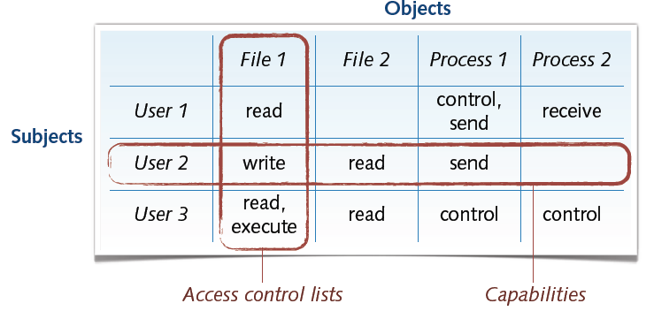
Representation: Access Control Lists
Access control lists (ACL) is a list of permissions attached to an object (such as a file, directory, or network resource).
Each entry in the list specifies which users or processes (subjects) can access the object and what actions (read, write, execute, etc.) they are allowed to perform.
Attachment of permissions to objects (columns)
⊕ Efficient and decentralize organization of permissions
⊖ Listing of subject permissions very involved
Example:
For a file named document.txt, the ACL might specify:
User Alice: Read, Write
User Bob: Read only
Group Admin: Full access (Read, Write, Execute)
Example: OpenBSD packet filter
Deny access to the SSH service from any host
→ block in quick proto tcp from any to any port ssh
OpenBSD Packet Filter (PF) is a powerful and flexible firewall software tool included in the OpenBSD operating system

Slide 5
Representation: Capabilities
Capabilities are a set of permissions that are attached to subjects (users or processes), specifying what actions they can perform on system objects.
Attachment of permissions to subjects (rows)
⊕ Listing and control of subject permissions simple
⊖ Fine-grained permissions difficult to implement
Example: Linux capabilities
Restrict specific permissions such as rebooting the system and loading kernel modules.
Command: lcap -z CAP_SYS_BOOT CAP_SYS_MODULEThis command sets the capabilities CAP_SYS_BOOT (to reboot the system) and CAP_SYS_MODULE (to load kernel modules) for the specified subject.
Example: An Android application requests the capability to access the device's camera.

Slide 6
Differences:
ACLs are object-centric. They are focused on what each object (file) allows different users to do.
Capabilities are subject-centric. They focus on what each user or process is allowed to do with different objects.
Notes:
In practice, an access matrix is usually sparse and is implemented by decomposition in one of two ways. The matrix may be decomposed by columns, yielding access control lists (ACLs); see Figure 4.2b. For each object, an ACL lists users and their permitted access rights. The ACL may contain a default, or public, entry. This allows users that are not explicitly listed as having special rights to have a default set of rights. The default set of rights should always follow the rule of least privilege or read-only access, whichever is applicable. Elements of the list may include individual users as well as groups of users.
When it is desired to determine which subjects have which access rights to a particular resource, ACLs are convenient, because each ACL provides the information for a given resource. However, this data structure is not convenient for determining the access rights available to a specific user.
Decomposition by rows yields capability tickets (Figure 4.2c). A capability
ticket specifies authorized objects and operations for a particular user. Each user
has a number of tickets and may be authorized to loan or give them to others.
Because tickets may be dispersed around the system, they present a greater
security problem than access control lists. The integrity of the ticket must be
protected, and guaranteed (usually by the operating system). In particular, the
ticket must be unforgeable. One way to accomplish this is to have the operating
system hold all tickets on behalf of users. These tickets would have to be held in
a region of memory inaccessible to users. Another alternative is to include an
unforgeable token in the capability. This could be a large random password, or a
cryptographic message authentication code. This value is verified by the relevant
resource whenever access is requested. This form of capability ticket is appropriate
for use in a distributed environment, when the security of its contents cannot
be guaranteed.
The convenient and inconvenient aspects of capability tickets are the opposite
of those for ACLs. It is easy to determine the set of access rights that a given user
has, but more difficult to determine the list of users with specific access rights for a
specific resource.

Slide 7

Management of Permissions
Discretionary Access Control (DAC)
Owner of an object controls access
Convenient but insecure if object changes owner
Mandatory Access Control (MAC)
System globally enforces access control
Very secure but tedious to design and operate
Role-based Access Control (RBAC)
System enforces access control using roles
In-between DAC and MAC models

Slide 8
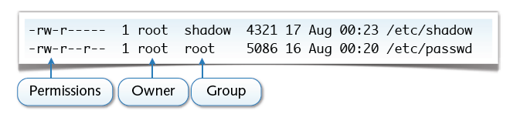
Example: UNIX Permissions
Discretionary access control of files
Owner manages permissions of his files
Fixed-size access control lists: rwx rwx rwx
Three subjects: user, group and other
Three permissions: read, write and execute
(a) Everybody can read the passwd file; root can write to it
(b) Only root and the group shadow can read the shadow file
This showcases the standard UNIX file permissions structure, where each file is assigned specific read, write, and execute rights for different categories of users.

Slide 9
Example: UNIX Permissions (con’t)
Simple notation for management of permissions
<subjects> +|-|= <permissions>
Subjects: u (user), g (group), o (others), a (all)
Permissions: r (read), w (write), x (execute)
Examples
Make file readable to everyone: chmod a+r file
Remove write permission from group: chmod g-w file
Make file readable by user only: chmod u=r file
Alternative for UNIX gurus: octal encoding
An alternative to symbolic notation is using octal encoding, commonly used by advanced UNIX users (gurus). This approach uses numbers (e.g., 755) to represent permissions.

Slide 10
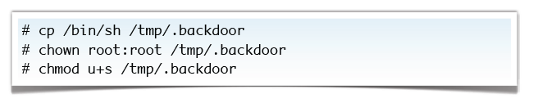
Special Permissions
Some permissions with special semantics
+x makes directories searchable
+t sticky bit (for directories deletion is restricted)
+s suid bit (change user id to file owner during execution)
A UNIX backdoor from the 1990s
If it’s bad, why do we need the suid bit?

Slide 11
Role Based Access Control (RBAC)
Definition
RBAC block diagram
RBAC₀ – Base Model
RBAC supports three well-known security principles.
Case Study: RBAC for a Bank
Attribute Based Access Control
Definition
ABAC Logical Architecture
Three Key attributes of ABAC Model
ABAC Policy Model
Online Entertainment Store Scenario
Specifying a RBAC Model
Specifying a ABAC Model
Comparing RBAC and ABAC models for the scenario

Slide 12
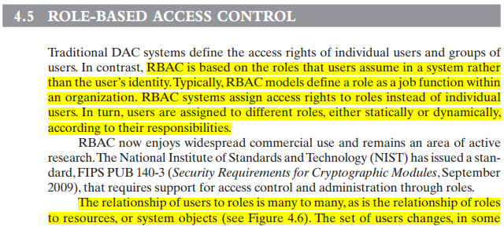
RBAC vs. DAC:
DAC (Discretionary Access Control) defines access based on individual users or groups.
RBAC assigns access based on roles users assume within a system, not user identity.
Roles and Access Rights:
A role typically represents a job function within an organization.
Access rights are assigned to roles, and users are then assigned to roles, either statically or dynamically based on responsibilities.
Many-to-Many Relationships:
The relationship between users and roles is many-to-many, as is the relationship between roles and resources (or system objects).
Users and their roles may change dynamically in environments where users frequently shift roles.
Role and Resource Set Stability:
The set of roles in most environments tends to be relatively static, with only occasional updates.
Each role has specific access rights to resources, but the associated access rights and roles themselves do not change often.

Slide 13






Basic RBAC Illustrated
Users
Roles
Permissions (Objects)
Relations:
Role 1
User
Assignment (UA)
Role 2
Permission Assignment (PA)
Role 3

Slide 14
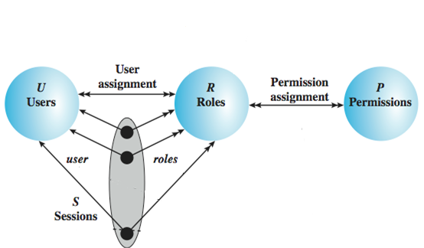
RBAC₀ – Base Model
Users: individuals with access to the system
Role: named job function within the org
Permission: approval of a particular mode of access to objects
Session: mapping between a user and a subset of roles
Notes:
Session example: UAC in Windows

Slide 15
Role-Based Access Control
RBAC supports three well-known security principles:
Least Privilege
Separation of duties
Data Abstraction
Least Privilege says that only minimum necessary rights should be assigned to a subject that requests access to a resource.
Separation of duties is achieved by ensuring that mutually exclusive roles must be invoked to complete a sensitive task.
Data abstraction is supported by means of abstract permissions such as credit and debit for an account.
The degree to which data abstraction is supported will be determined by the implementation details

Slide 16
Advantage of RBAC
Once implemented RBAC simplifies system administration
Once roles are defined and implemented, RBAC significantly reduces the administrative workload.
Strong support for separation of duties
RBAC enforces clear separation of duties by assigning different permissions to distinct roles.
Good auditing support
RBAC improves auditability since the access rights for resources are tied to roles, not individuals.
Considered best practice by many
Many organizations and security standards (such as NIST) consider RBAC a best practice for managing access control.
It offers a scalable, secure, and efficient model for access management, especially in environments with many users and complex access requirements.

Slide 17
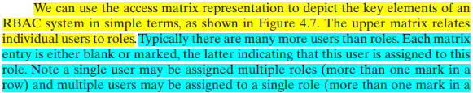

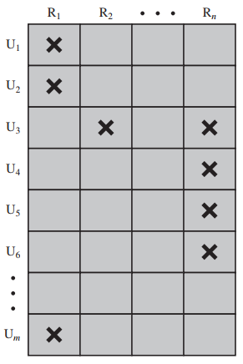
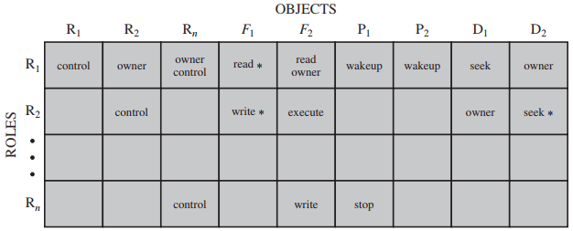
Each role should contain the minimum set of access rights needed for that role. A user is assigned to a role that enables him or her to perform only what is required for that role. Multiple users assigned to the same role enjoy the same minimal set of access rights.

Slide 18
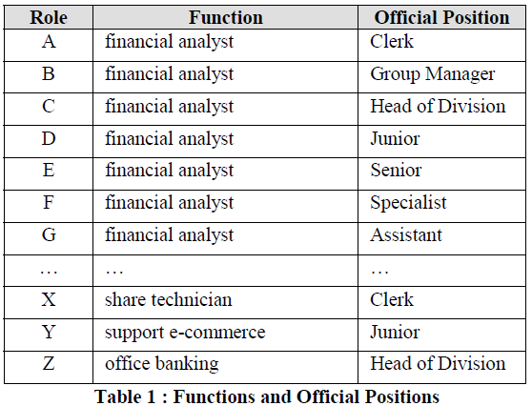
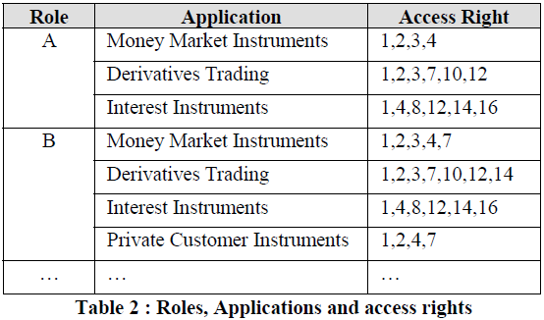
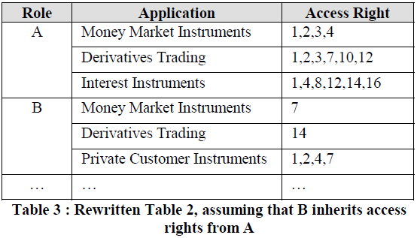
Case Study: RBAC for a Bank

